Slide 1
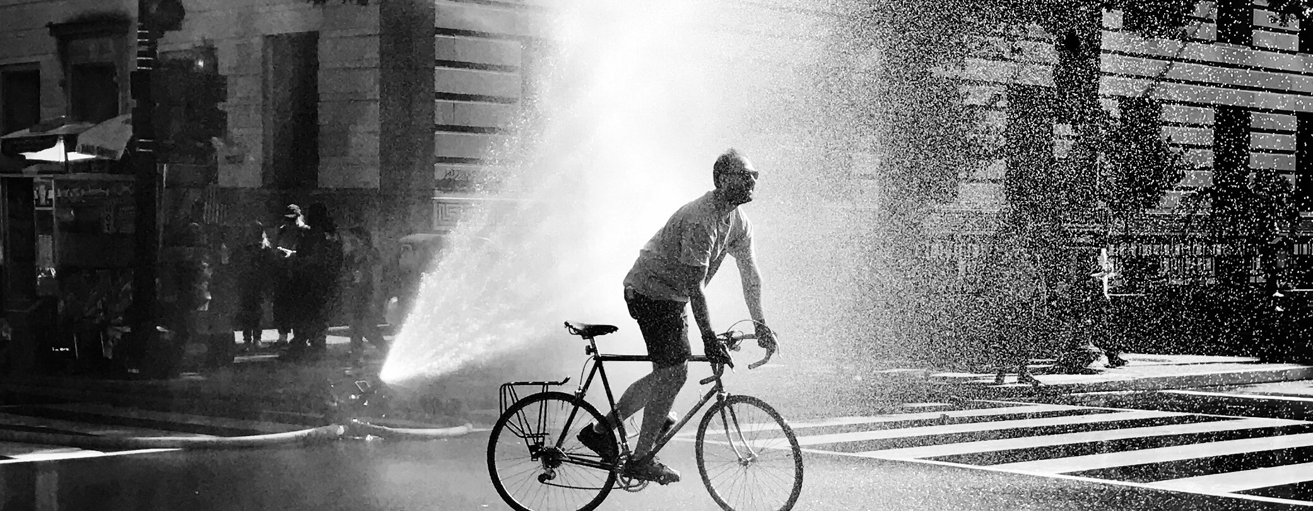

Context as interactive, dynamic & perspectival
Caroline Stankozi caroline.stankozi@rub.de
Doctoral Symposium „Context in Cognition“, Tübingen, 08/04/2025

Slide 2

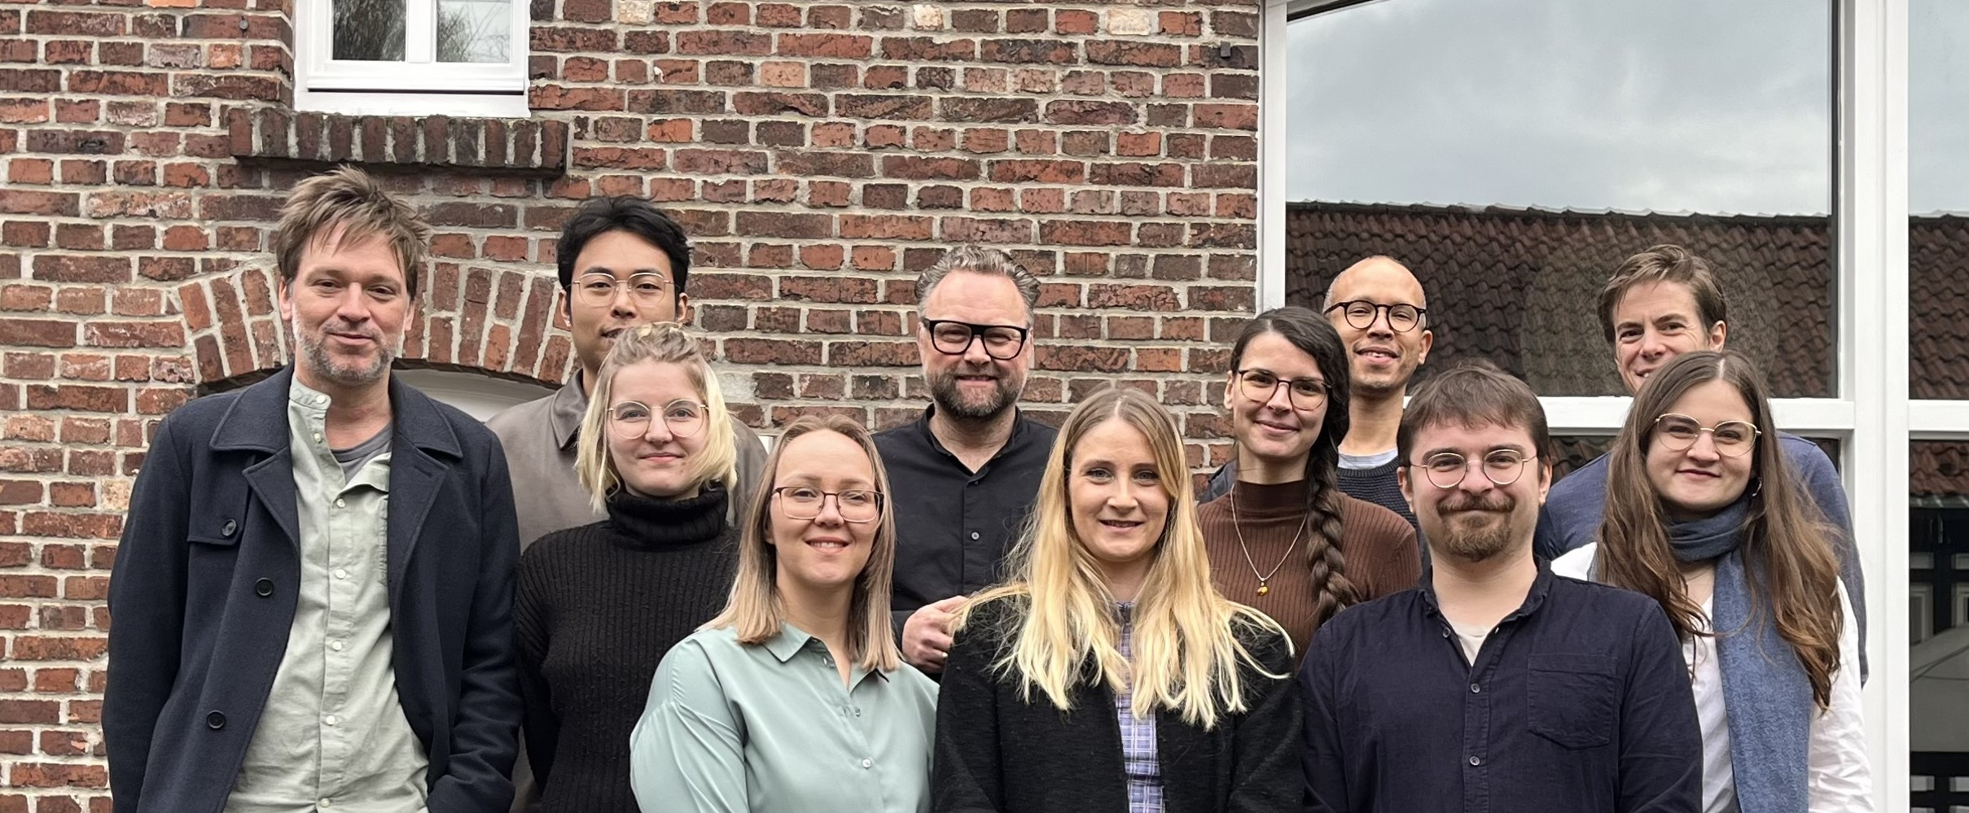
PhD project in Philosophy – supervisors
Prof. Dr. Tobias Schlicht Chair for Philosophy of Consciousness & Cognition (RUB)

Slide 3

PhD project in Philosophy – supervisors
Prof. Dr. Tobias Schlicht Chair for Philosophy of Consciousness & Cognition (RUB)
Prof. Dr. Kristin Andrews
York chair in Animal minds (York University, CA)

Slide 4

PhD project

Slide 5
PhD project – cognitive coupling

Slide 6
PhD project – cognitive coupling
Cognition

Slide 7
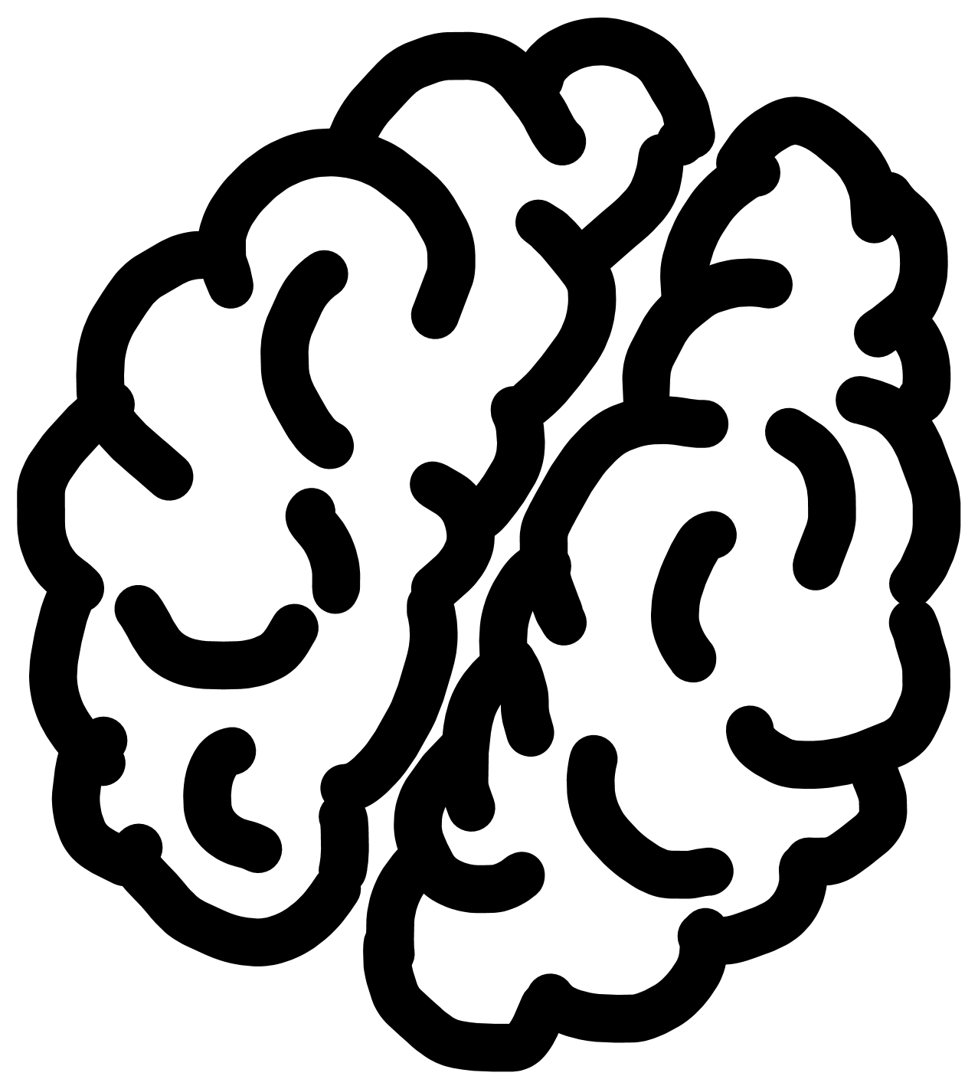
PhD project – cognitive coupling
Cognition

Slide 8

PhD project – cognitive coupling
Cognition

Slide 9

PhD project – cognitive coupling
Cognition

Slide 10
PhD project – cognitive coupling
Cognition
Lyon, Keijzer, Arendt, & Levin (2021)

Slide 11


Context
?
Complex

Slide 12




Context
?

Slide 13

Context
?

Slide 14

Context
?

Slide 15
Context
?

Slide 16
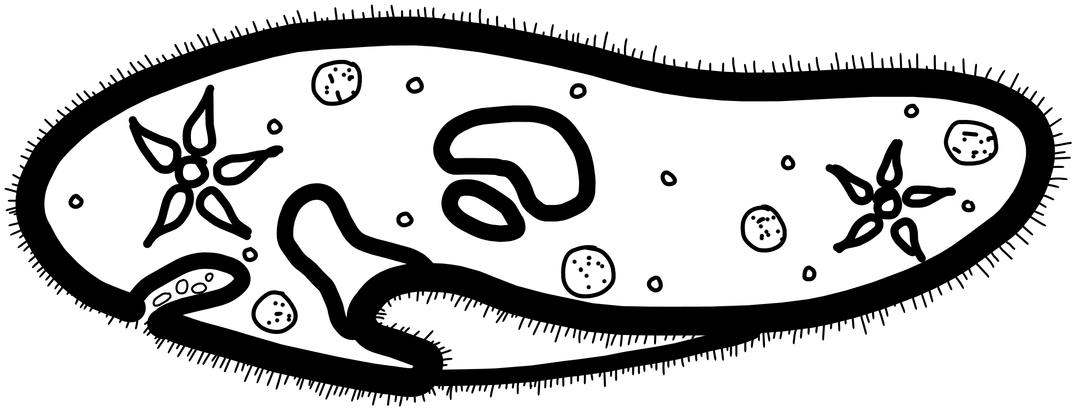
Context
?

Slide 17

Context
?

Slide 18
Context
?
Varela, Thompson & Rosch (1993)

Slide 19
Context
?

Slide 20
Context
?
anthropogenic

Slide 21
Context
?
anthropogenic
biogenic
Lyon (2006)

Slide 22

Conceptual distinction

Slide 23
Conceptual distinction
?
Objective environment

Slide 24
Conceptual distinction
?
Objective environment
Perspectival context

Slide 25
Conceptual distinction
?
Objective environment
Perspectival context
How does it arise?

Slide 26

Enactivism
Varela, Thompson & Rosch (1993)
Barandiaran, Di Paolo & Rohde (2009)
Thompson (2007)

Slide 27
Enactivism
Cognition = active doing (no passive perception)
Varela, Thompson & Rosch (1993)
Barandiaran, Di Paolo & Rohde (2009)
Thompson (2007)

Slide 28
Enactivism
Cognition = active doing (no passive perception)
Structural coupling
Varela, Thompson & Rosch (1993)
Barandiaran, Di Paolo & Rohde (2009)
Thompson (2007)

Slide 29
Enactivism
Cognition = active doing (no passive perception)
Structural coupling
Dynamic perception-action loops
Varela, Thompson & Rosch (1993)
Barandiaran, Di Paolo & Rohde (2009)
Thompson (2007)

Slide 30
Enactivism
Cognition = active doing (no passive perception)
Structural coupling
Dynamic perception-action loops
Sense-making
Varela, Thompson & Rosch (1993)
Barandiaran, Di Paolo & Rohde (2009)
Thompson (2007)

Slide 31
Enactivism
Structural coupling
Varela, Thompson & Rosch (1993)
Barandiaran, Di Paolo & Rohde (2009)
Thompson (2007)

Slide 32
Enactivism
Structural coupling
Sensory modalities
Varela, Thompson & Rosch (1993)

Slide 33
Enactivism
Structural coupling
Sensory modalities
Motor behaviour
Varela, Thompson & Rosch (1993)
Barandiaran, Di Paolo & Rohde (2009)

Slide 34
Enactivism
Structural coupling
Sensory modalities
Motor behaviour
→ interact
Varela, Thompson & Rosch (1993)
Barandiaran, Di Paolo & Rohde (2009)
Thompson (2007)

Slide 35
Enactivism
Structural coupling
Sensory modalities
Motor behaviour
→ interact
Relevance?
Varela, Thompson & Rosch (1993)
Barandiaran, Di Paolo & Rohde (2009)
Thompson (2007)

Slide 36
Enactivism
Structural coupling
Sensory modalities
Motor behaviour
→ interact
Relevance?
→ can be regulated to stay viable / socially accepted, etc.
(enables learning)
Varela, Thompson & Rosch (1993)
Barandiaran, Di Paolo & Rohde (2009)
Thompson (2007)

Slide 37
Enactivism
Structural coupling
Sensory modalities
Motor behaviour
→ interact
Relevance?
→ can be regulated to stay viable / socially accepted, etc.
(enables learning)
Interactive
Varela, Thompson & Rosch (1993)
Barandiaran, Di Paolo & Rohde (2009)
Thompson (2007)

Slide 38
Enactivism
Dynamic perception-action loops
Di Paolo, Buhrmann & Barandiaran (2017)
Gangopadhyay & Kiverstein (2009)
Aydede & Robbins (2008)

Slide 39
Enactivism
Dynamic perception-action loops
Metabolic needs (e.g., starvation)
Di Paolo, Buhrmann & Barandiaran (2017)

Slide 40
Enactivism
Dynamic perception-action loops
Metabolic needs (e.g., starvation) [or other goals]
Di Paolo, Buhrmann & Barandiaran (2017)

Slide 41
Enactivism
Dynamic perception-action loops
Metabolic needs (e.g., starvation) [or other goals] → regulatory behaviour (e.g., active feeding)
Di Paolo, Buhrmann & Barandiaran (2017)

Slide 42
Enactivism
Dynamic perception-action loops
Metabolic needs (e.g., starvation) [or other goals] → regulatory behaviour (e.g., active feeding)
→ complimentary perception (e.g., rich feeding grounds)
Di Paolo, Buhrmann & Barandiaran (2017)

Slide 43
Enactivism
Dynamic perception-action loops
Metabolic needs (e.g., starvation) [or other goals] → regulatory behaviour (e.g., active feeding)
→ complimentary perception (e.g., rich feeding grounds)
Perception for action ∞
Di Paolo, Buhrmann & Barandiaran (2017)
Gangopadhyay & Kiverstein (2009)

Slide 44
Enactivism
Dynamic perception-action loops
Metabolic needs (e.g., starvation) [or other goals] → regulatory behaviour (e.g., active feeding)
→ complimentary perception (e.g., rich feeding grounds)
Perception for action ∞
Relevance?
Di Paolo, Buhrmann & Barandiaran (2017)
Gangopadhyay & Kiverstein (2009)
Aydede & Robbins (2008)

Slide 45
Enactivism
Dynamic perception-action loops
Metabolic needs (e.g., starvation) [or other goals] → regulatory behaviour (e.g., active feeding)
→ complimentary perception (e.g., rich feeding grounds)
Perception for action ∞
Relevance?
→ changes over time, according to a situated task
Di Paolo, Buhrmann & Barandiaran (2017)
Gangopadhyay & Kiverstein (2009)
Aydede & Robbins (2008)

Slide 46
Enactivism
Dynamic perception-action loops
Metabolic needs (e.g., starvation) [or other goals] → regulatory behaviour (e.g., active feeding)
→ complimentary perception (e.g., rich feeding grounds)
Perception for action ∞
Relevance?
→ changes over time, according to a situated task
Dynamic
Di Paolo, Buhrmann & Barandiaran (2017)
Gangopadhyay & Kiverstein (2009)
Aydede & Robbins (2008)

Slide 47
Enactivism
Sense-making
Thompson (2007)
See Hutto & Myin (2013) for a critical discussion
See Stankozi (2024) for a relation to affordances / ecological psychology

Slide 48
Enactivism
Sense-making
i.e., co-creating what one senses
Thompson (2007)
See Hutto & Myin (2013) for a critical discussion
See Stankozi (2024) for a relation to affordances / ecological psychology

Slide 49
Enactivism
Sense-making
i.e., co-creating what one senses
Perception
Thompson (2007)
See Hutto & Myin (2013) for a critical discussion
See Stankozi (2024) for a relation to affordances / ecological psychology

Slide 50
Enactivism
Sense-making
i.e., co-creating what one senses
Perception
Not passive
Thompson (2007)
See Hutto & Myin (2013) for a critical discussion
See Stankozi (2024) for a relation to affordances / ecological psychology

Slide 51
Enactivism
Sense-making
i.e., co-creating what one senses
Perception
Not passive
Situated
Thompson (2007)
See Hutto & Myin (2013) for a critical discussion
See Stankozi (2024) for a relation to affordances / ecological psychology

Slide 52
Enactivism
Sense-making
i.e., co-creating what one senses
Perception
Not passive
Situated
Informed by & informing action
Thompson (2007)
See Hutto & Myin (2013) for a critical discussion
See Stankozi (2024) for a relation to affordances / ecological psychology

Slide 53
Enactivism
Sense-making
i.e., co-creating what one senses
Perception
Not passive
Situated
Informed by & informing action
Relevance?
Thompson (2007)
See Hutto & Myin (2013) for a critical discussion
See Stankozi (2024) for a relation to affordances / ecological psychology

Slide 54
Enactivism
Sense-making
i.e., co-creating what one senses
Perception
Not passive
Situated
Informed by & informing action
Relevance?
→ created interactively by an organism and its environment (i.e., context)
Thompson (2007)
See Hutto & Myin (2013) for a critical discussion
See Stankozi (2024) for a relation to affordances / ecological psychology

Slide 55
Enactivism
Sense-making
i.e., co-creating what one senses
Perception
Not passive
Situated
Informed by & informing action
Relevance?
→ created interactively by an organism and its environment (i.e., context)
Perspectival
Thompson (2007)
See Hutto & Myin (2013) for a critical discussion
See Stankozi (2024) for a relation to affordances / ecological psychology

Slide 56

Context

Slide 57
Context
Interactive
Kaiser & Trappes (2023)

Slide 58
Context
Interactive (not passive)
Kaiser & Trappes (2023)

Slide 59
Context
Interactive (not passive) -> consider how agents constantly change their context (niche construction)
Kaiser & Trappes (2023)

Slide 60
Context
Interactive (not passive) -> consider how agents constantly change their context (niche construction)
Dynamic
Kaiser & Trappes (2023) Baedke, Fábregas-Tejeda & Prieto (2021)

Slide 61
Context
Interactive (not passive) -> consider how agents constantly change their context (niche construction)
Dynamic (not static)
Kaiser & Trappes (2023) Baedke, Fábregas-Tejeda & Prieto (2021)

Slide 62
Context
Interactive (not passive) -> consider how agents constantly change their context (niche construction)
Dynamic (not static) -> consider the history: environmental fluctuations & experiences (evo-devo)
Kaiser & Trappes (2023) Baedke, Fábregas-Tejeda & Prieto (2021)

Slide 63
Context
Interactive (not passive) -> consider how agents constantly change their context (niche construction)
Dynamic (not static) -> consider the history: environmental fluctuations & experiences (evo-devo)
Perspectival
Kaiser & Trappes (2023) Baedke, Fábregas-Tejeda & Prieto (2021)
De Haan (2020)

Slide 64
Context
Interactive (not passive) -> consider how agents constantly change their context (niche construction)
Dynamic (not static) -> consider the history: environmental fluctuations & experiences (evo-devo)
Perspectival (not objective)
Kaiser & Trappes (2023) Baedke, Fábregas-Tejeda & Prieto (2021)
De Haan (2020)

Slide 65
Context
Interactive (not passive) -> consider how agents constantly change their context (niche construction)
Dynamic (not static) -> consider the history: environmental fluctuations & experiences (evo-devo)
Perspectival (not objective) -> consider the organism‘s previous encounters, movements, habits, needs, & preferences (situatedness)
Kaiser & Trappes (2023) Baedke, Fábregas-Tejeda & Prieto (2021)
De Haan (2020)

Slide 66
Conceptual distinction
?
Objective environment
Perspectival context

Slide 67
Thank you:

Slide 68
Thank you:
Tübingen, for being here!
caroline.stankozi@rub.de

Slide 69
Thank you:
Tübingen, for being here!
Prof. Tobias Schlicht & his team, for all their support!
caroline.stankozi@rub.de

Slide 70

Thank you:
Tübingen, for being here!
Prof. Tobias Schlicht & his team, for all their support!
RTG Situated Cognition, for making me an associate & financing this trip
caroline.stankozi@rub.de

Slide 71

Thank you:
Tübingen, for being here!
Prof. Tobias Schlicht & his team, for all their support!
RTG Situated Cognition, for making me an associate & financing this trip
Ruhr University Research School funded by Germany’s Excellence Initiative [DFG GSC 98/3], for their generous support
caroline.stankozi@rub.de

